Slide 1
The Enlisted Association Chapter 39
15821 E Centretech Cir
Aurora Co 80011
15821 E Centretech Cir
Aurora CO 80011
303-340-3939
October, November, & December 2022

Slide 2
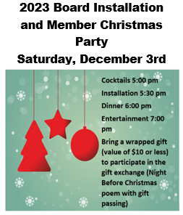
A WORD FROM THE PRESIDENT
THINGS TO DO AT CHAPTER 39
SEE CALENDARS FOR DETAILS
I’m writing to inform you that Chapter 39 received a letter from the IRS automatically revoking the Chapters tax exempt status. The Reason given was not filing our IRS Form 990 for 3 consecutive years.
The IRS has the chapters 990s for tax year 2018 and 2021.
Tax years 2019 and 2020 we not filed or not filed correctly. Tax year 2021 was filed 15 days late.
The chapter has contracted with a professional tax service to reconstruct the 990’s for tax years 2019 and 2020 and submit them in accordance with IRS Revenue Procedure 2011-14 Section 5 RETROACTIVE REINSTATEMENT OF TAX-EXEMPT STATUS WITHIN 15 MONTHS OF REVOCATION.
The chapter Games Manager proactively contacted the Colorado Secretary of State’s office to inform them of the above letter and to ascertain the impact to our gaming license. The Games Manager was asked to send them a copy of the IRS letter and the Secretary of State office stated that at this time there is no impact to our gaming license.
To keep this from happening in the future the chapters Board of Directors will recommend to the General Membership, at the September meeting, an addition to the chapters By Laws and Standing Rules making it mandatory for the President and Treasurer, acting on the Boards behalf, to contract with a tax professional in December of each year for preparation of that tax years Form 990 prior to the form due date, currently on May 15th of the year following the close of each tax year. This will ensure that the chapters tax forms are prepared professionally and submitted on time each year.
TREA National has been notified of the above.
Further updates as they are available will be reported at monthly membership meetings.
Thank you,
Clarence “CJ” Johnson
Bison Burger Dinner July 16th
October 1st 5:30-7pm
A WORD FROM THE AUXILIARY
The Auxiliary wants to thank everyone who buys our bake goods. And a big thank you to Shirley, who donated the bottle of Crown Royal which made our Father’s Day basket a great success. Mr. Sam was our big winner on the basket.
Thank you for the ones who came to the Wine Tasting in August. We all ate good and had a great time. Thank you for all that help making it a great success.
United We Stand
Helen Suggs
Queen of Hearts drawing every Saturday at 7:00pm.

Slide 3
MANAGER’S MINUTE
CHAPLAIN’S CORNER
After the passing of Father John, we include this excerpt from an article he wrote last year:
…We are all anxious to get out and spread our wings. Especially this year as we begin to come out of the pandemic. Your A&E committee is busy scheduling dinners and activities with the help of the Auxiliary. We need your presence for these events to be successful. Come out, please, to support the club. The 3rd Wednesday of the month is our General Membership meeting. Our last session was full of new ideas. That is your opportunity to make suggestions on how we can get better. But it all hinges on your participation and support. Volunteering to help in any way for as little as 2 hours a week helps a lot! We need the help of all our members (and club members) to support our activities, dinners, bands, karaoke, trivia, and our very own Blake. Check the calendars for appearance dates. I also would like to invite you to come in for Christine Jones. She is a dynamite performer who takes over the stage. We can make things better if we all give a little of ourselves. Who knows, you might even have a good time!
Father John Green
Greetings,
It has been great to see so many folks returning, but we’re still missing some friends. Please check out all the different activities on the attached calendars and come see us. The Activities and Entertainment Committee works very hard to plan events so that there is something for everyone. But that only happens if you share what you would like to see. Please either come to a meeting or contact a member of the committee to share your thoughts. The committee is open to ALL members, not just Chapter.
There are many fun events planned through the end of the year, please see the calendars attached and come out and see us. And as always, this is your Club, let me know what you’d like to see!
Charlie Keith
Club Manager
ELECTIONS ARE HAPPENING!
Please remember to come in and vote for your 2023 TREA Chapter 39 Board of Directors and the 2023 TREA Chapter 39 Auxiliary Board of Directors
Chapter Election Night: November 16th at 6:00
Auxiliary Election Night: November 20th at 1:00
MEMBERSHIP REPORT
Hello Everyone!
Please make sure to update your information with TREA National for Chapter members and TREA Chapter 39 for club members. Having an email address on file is the best way for us to get information out to you. If you could email that info to me, it would be much appreciated: membership@trea39.org.
If you’re a “Club” member and haven’t been to the Club in a while, we are OPEN for business! If you would like to renew your membership, come in and fill out a new form. Membership is $30 a year (additional $5 for a door key card). We have some exciting events in October, November, and December.
If you are on Facebook, go to our FB page and Follow/Like: TREA Chapter 39
You can also go to our website to check out the monthly calendar and new hours of operation: http://www.treach39.qwestoffice.net
Hope to see you soon,
Christine Johnson
Membership
CHARITY REPORT
Our 2022 goal is to raise $1,500 and as of August 31st, we have raised $1,800!!
Distribution of funds have already been made to the following charities: COMITIS Crisis Center/Veterans Community Living Center/Honor Bell/TREA Gives Program/Freedom Service Dogs/Wreaths Across America.
Wreaths Across America – TREA Chapter 39, will be attending this annual event on, Saturday, December 17th, at Fairmount Cemetery. We need to arrive NLT 9:30am for a one-hour ceremony and then distribute wreaths at 10:30 – 1:30. Parking is allowed along the roadways, with the exception of the Veterans Memorial section. If you would like to participate, you can let me know via email: treasurer@trea39.org or put your name on the sign-up sheet at the bar, which will be available mid-November.
Hope to see you soon,
Christine Johnson
Charity
Why are trees so carefree and easygoing?
Because every fall, they let loose.

Slide 4
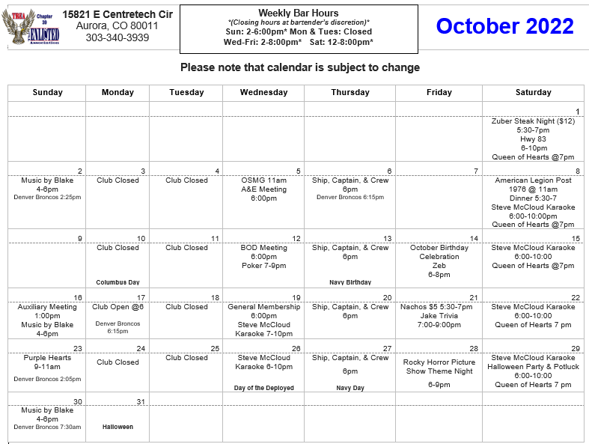

Slide 5
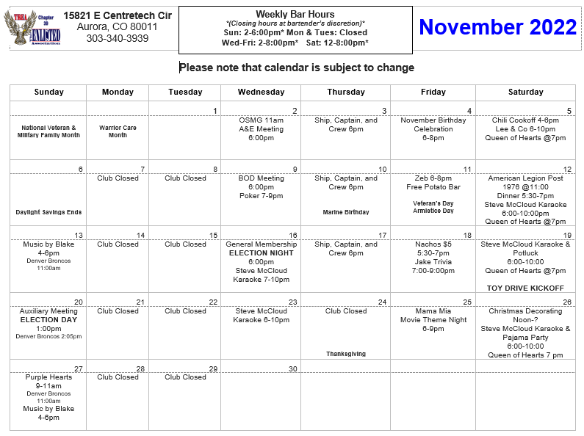

Slide 6
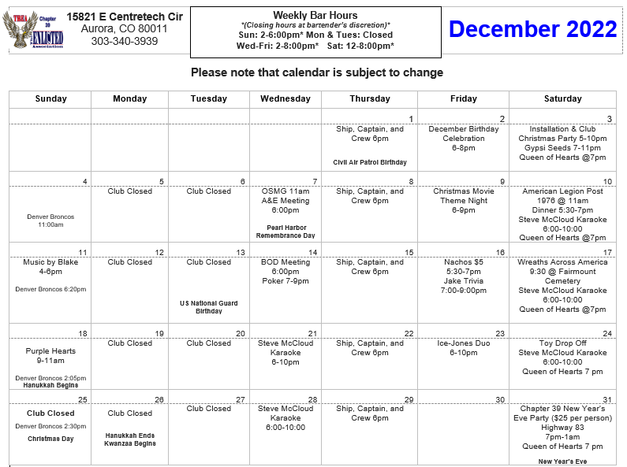
“Start every day off with a smile and get it over with.” — WC Fields

